Slide 1
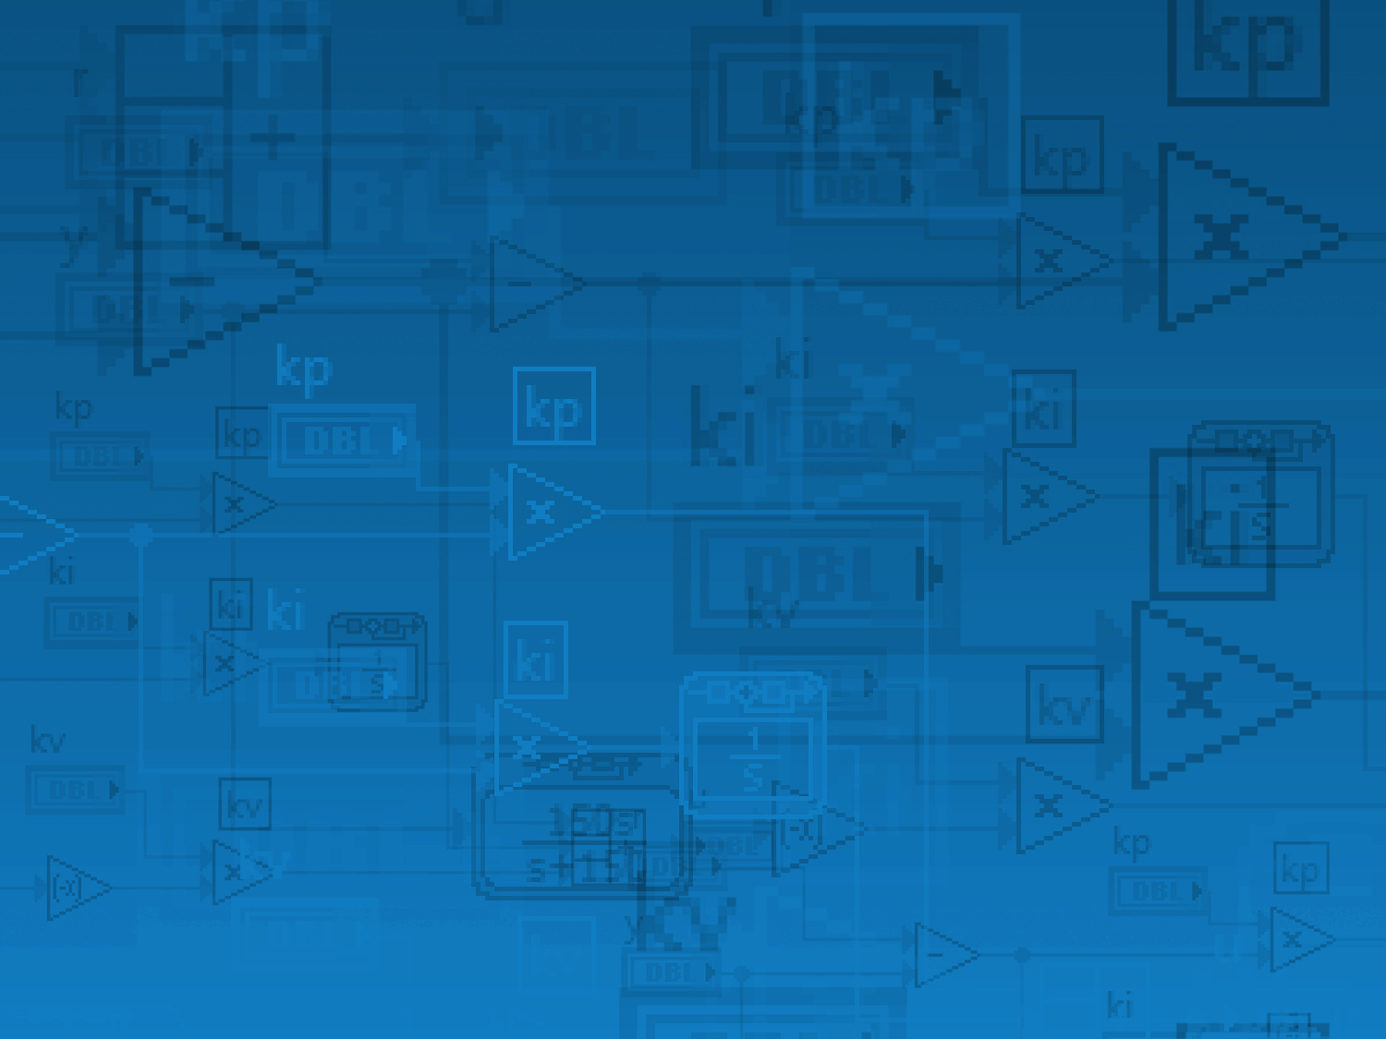
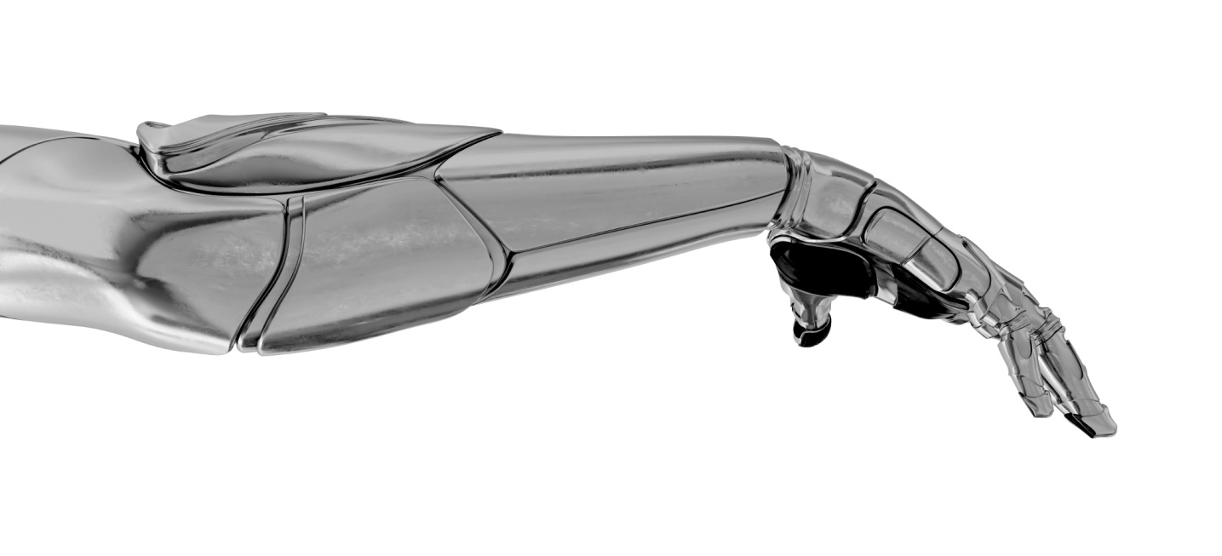
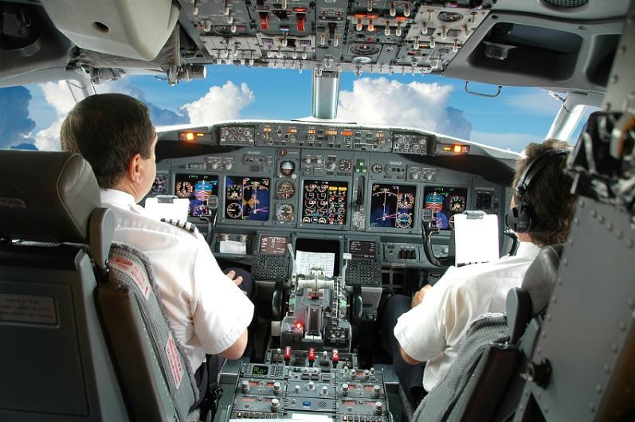
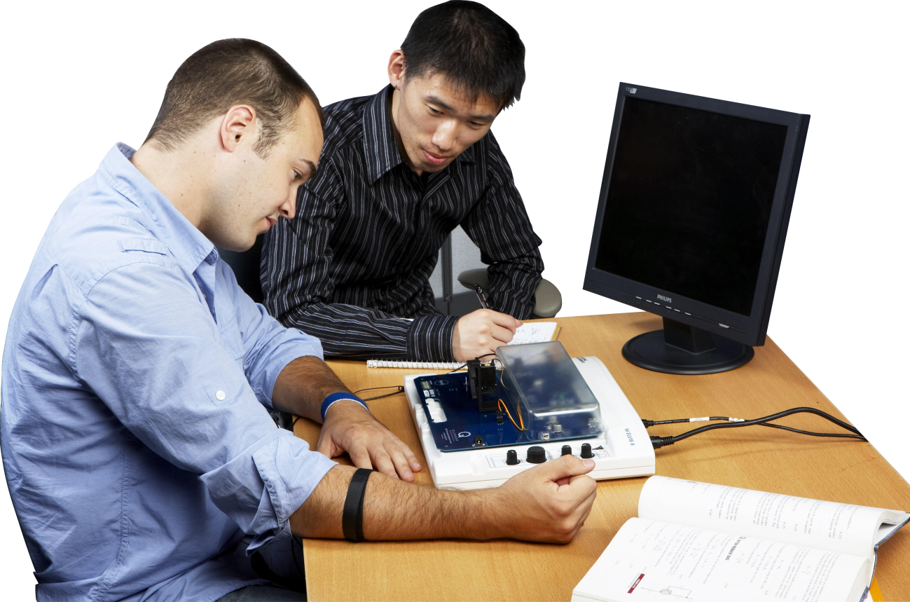
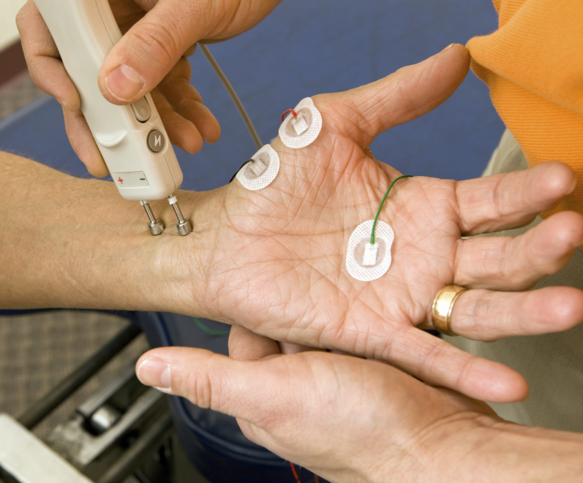


Quanser QNET Myoelectric Trainer Overview
QNET Myoelectric Trainer
QNET lab experiments are designed for NI ELVIS by Quanser

Slide 2
Introduction
Subjects Learned in the QNET Myoelectric Trainer:
Signal Processing
Zero-Order Hold
The principles of mechanical, electrical and computer controls can be demonstrated in the trainer.

Slide 3
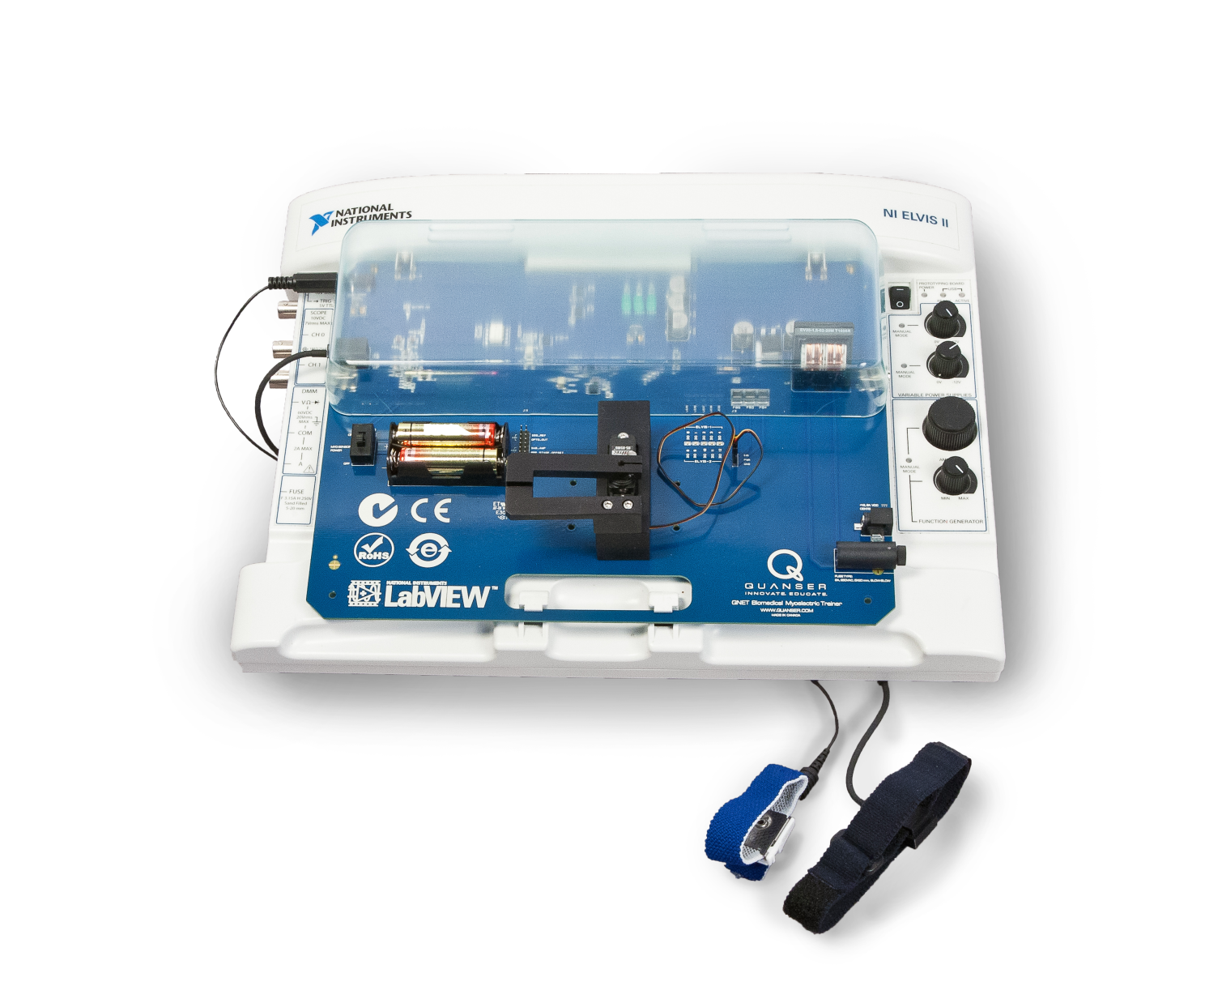
Myoelectric Trainer

Slide 4
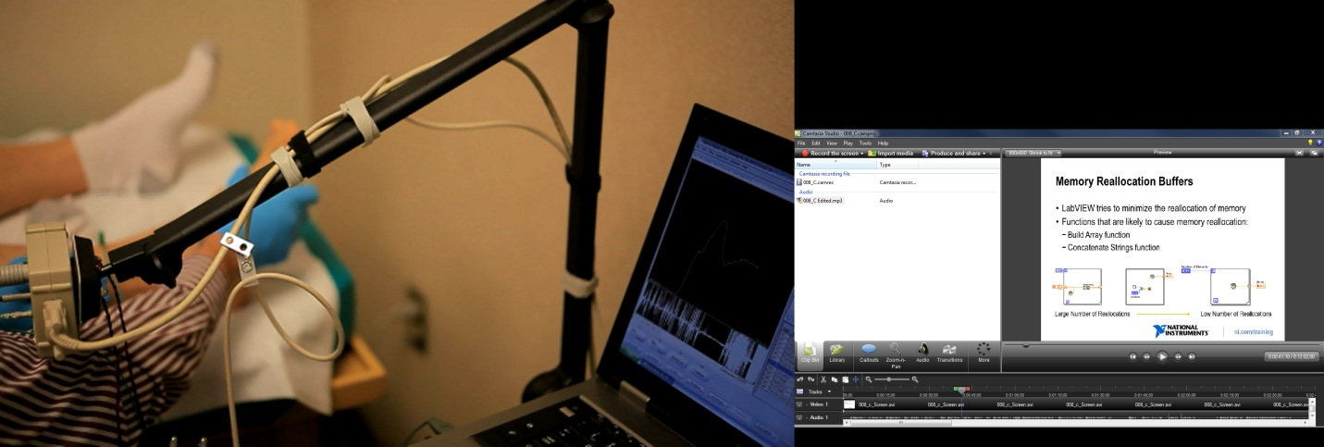
Sensor Setup
These experiments investigate how the body emits a voltage through muscles when they are flexed and not flexed.
This type of investigation is done in the field of medicine to look for muscle abnormalities.
**Need a still-shot of the video that Quanser should be sending us.**

Slide 5
EMG Signals
Electromyography, or EMG, involves acquiring and studying the electrical activity of muscles.
An electromyograph measures the electric potential generated by muscle cells.
EMG signals are very noisy and have a very small amplitude within a range of about 5mV.

Slide 6
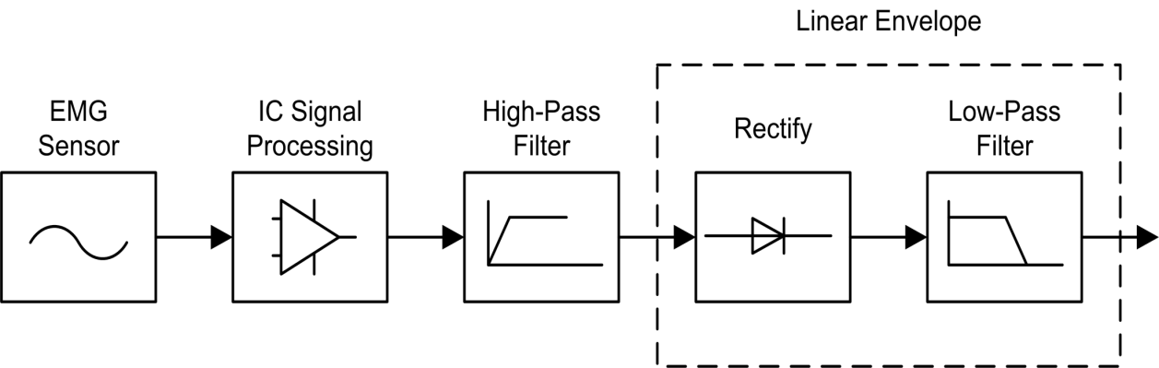
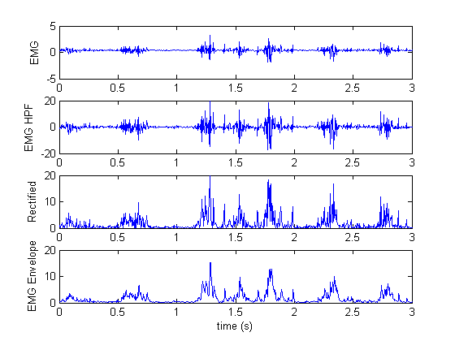
Signal Processing

Slide 7
Signal Processing
Decoding the electrical muscle activity into a useable signal is critical in device operations. This would allow someone to control an independent device by flexing their muscles.
A wide array of signal processing must be done to interpret an EMG signal.
This knowledge of signal processing can be transferred to areas such as circuitry, electronics and audio and video components.

Slide 8
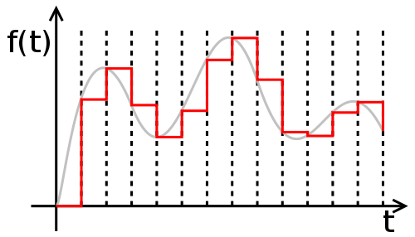
Zero Order Hold (ZOH)
Zero Order Hold takes a sample of the signal at a given time and extends it over a certain period to create a continuous signal.
This technique is commonly used in digital-to-analog converters.

Slide 9
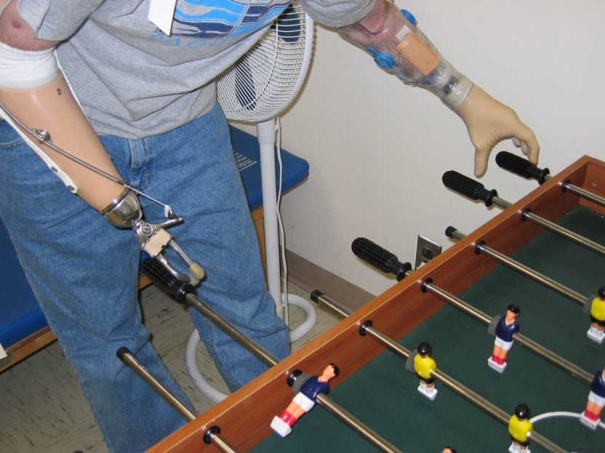
EMG Control
We investigate servo control using the EMG signal.
The principles demonstrated are transferable to prosthetic devices and bio instrumentation technologies.

